Slide 1
^{EVENTS MANAGEMENT}

Slide 2
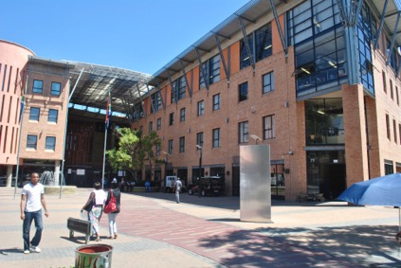
^{CONTENTS}
^{1.} ^{Table of Contents}
^{2. Introduction / Background}
^{3. Objectives}
4. Event Management Unit Structure
^{5. Events Process Flow}
^{6. Event Types}
^{7. Additional Services}
^{8. Timelines}

Slide 3
^{INTRODUCTION / BACKGROUND}
The Events Management Directorate is responsible for providing strategic events management support to all identified and or initiated departmental events
Once these events have been identified the unit will organize, coordinate and manage execution process.
The events unit also manages all identified commemorative events .
Additional to the event management services, the unit is also responsible for the procurement of the departmental branding and promotional materials.

Slide 4
^{OBJECTIVES}
To strategically align the dtic events through the use of divisional Ops Plans.
To facilitate and organize commemorative events that promote social cohesion as identified on the DIRCO’s annual calendar.
To align the dtic events calendar to the COTII agencies for maximum funding and market exposure.
To clarify roles and responsibilities within the Chief Directorate.
To maximise brand presence in all departmental events.

Slide 5
^{EVENTS MANAGEMENT STRUCTURE}
Director
Assistant Director
Intern
Senior Communication Officer
Senior Communication Officer

Slide 7
^{EVENTS TYPES}
Events types that are managed by the Directorate:
Conferences
Indaba’s
Launches
Workshops
Awards
Seminars
Symposiums
Commemorative events

Slide 8
^{ADDITIONAL SERVICES}
Additional services offered:
Branding materials
Promotional materials
Name badges for the dtic employees.

Slide 9
^{EVENTS TIMELINES}

Slide 10
THANK YOU

